Slide 1
CLIMATE ACTION
– CARBON FOOTPRINT
Webpage for Ideal Eco-Friendly Vehicle suggestion
Backend Boys
Shiyam Ganesh T Vikrant R Rohit D Tharun R S

Slide 2
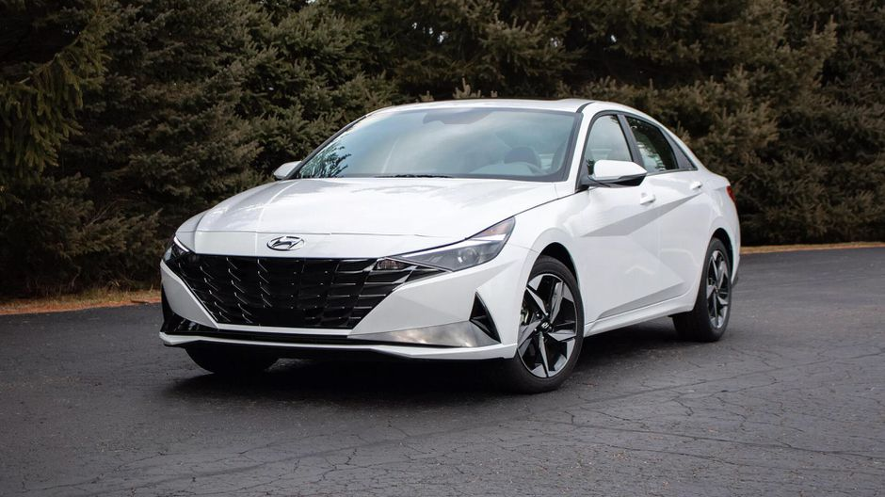
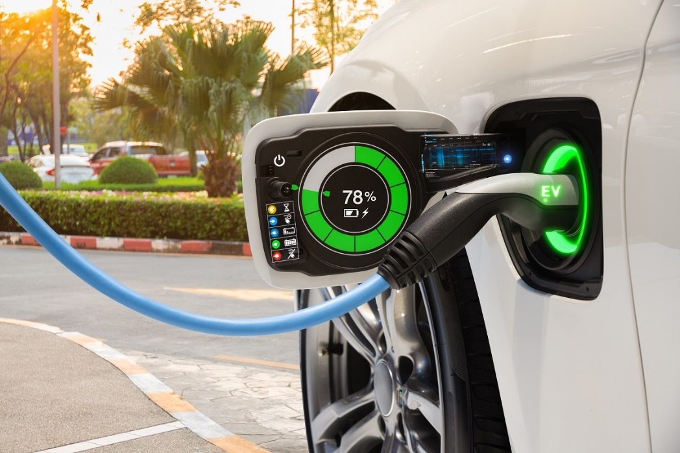
Introduction
When it comes to our environment, each of us bear a responsibility. The carbon emission from vehicles is a major contributor to global warming. This will greatly impact global climate change.
Carbon Footprint - Carbon footprint is the total amount of greenhouse gases (including carbon dioxide and methane) that are generated by our actions.
So our Webpage will suggest you the ideal vehicle for your needs which also has minimal carbon footprint and thus, minimal impact on our environment.

Slide 3




Inputs Required from the user:
Mileage and fuel type of the old car owned (If any).
2. Travel Distance.
3. Type of car (Sedan/SUV/Hatchback).
Outputs:
1. Car suggestions with minimal carbon footprint based on the input.
2. The carbon footprint is displayed for every car suggested in a year.
3. EV Suggestions, Public Transport Suggestion with approximate c.f. numbers.
4. *Comparison of Carbon emissions with the user’s current vehicle (If Any).
Additional ideas/Further Improvements:
Calculations of on-road price.
Location of near by second hand dealers and discounts available.

Slide 4
Implementation
PETROL
[Assuming the number of days
vehicle is being used per week is 5]
Carbon Footprint per year = (distance/mileage) * 2.38 * 260;
DIESEL
[Assuming the number of days
vehicle is being used per week is 5]
Carbon Footprint per year = (distance/mileage) * 2.63 * 260;
Calculation of Carbon Footprint of Bus
mileage = (Distance/4.5)* (co2 emission per litre of diesel/seating capacity)
= (Distance/4.5) * (2.63/50)
= (Distance) * 0.0116

Slide 5
Conclusion
This project is one small step taken by us, towards protecting the environment.
The least we can do is to try to influence the user to buy a vehicle with lower carbon footprint
and also to suggest them to buy electric vehicles or use public transport.
Per capita emission of buses will be less for public transport
Additional ideas/Further Improvements:
Calculations of on-road price based on user’s location.
Location of nearby second hand dealers and discounts available.
The project can be extended further for two-wheelers

